Slide 1
3.31 meeting RNN & LSTM 컴퓨터소프트웨어학부 심승현

Slide 2
목차
How to deal with sequential data ?
RNN
LSTM

Slide 3
Sequential Data
- 데이터 셋 안에 있는 데이터들이 순서를 가지는 데이터
(e.g. 텍스트, 소리 신호, DNA 염기서열 등)
- 순서가 변경되면 의미가 변경되는 특성이 있음
In Deep learning, how can we deal with sequential data?

Slide 4
RNN, recurrent neural network
〮 Sequential data 가 있을 때, 이전 step에서의 output과
현재 step에서의 input 을 함께 고려하여, 현재 step의 output 을 도출한다.

Slide 5
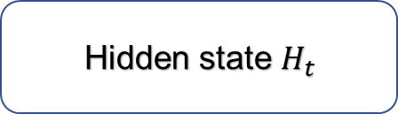



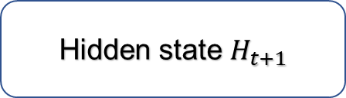

RNN, recurrent neural network
Hidden state $H_{t}$
Hidden state $H_{t+1}$
*$W_{hh}$
*$W_{xh}$
Input $X_{t}$
Input $X_{t+1}$

Slide 6



RNN, recurrent neural network
Hidden state $H_{t}$
Hidden state $H_{t+1}$
*$W_{hh}$
*$W_{hh}$
$$H_{t−1}$$
*$W_{xh}$
*$W_{xh}$
Input $X_{t}$
Input $X_{t+1}$

Slide 7


RNN, recurrent neural network
Hidden state $H_{t}$
Hidden state $H_{t+1}$
*$W_{hh}$
+bias
*$W_{hh}$
+
$$H_{t−1}$$
Parameter matrix
*$W_{xh}$
*$W_{xh}$
Input $X_{t}$
Input $X_{t+1}$

Slide 8

RNN, recurrent neural network
Hidden state $H_{t}$
Hidden state $H_{t+1}$
Non-linear
Activation function ( tanh )
*$W_{hh}$
+bias
*$W_{hh}$
+
$$H_{t−1}$$
Parameter matrix
*$W_{xh}$
*$W_{xh}$
Input $X_{t}$
Input $X_{t+1}$

Slide 9


RNN, recurrent neural network
Hidden state $H_{t}$
Hidden state $H_{t+1}$
Non-linear
Activation function ( tanh )
Non-linear
Activation function ( tanh )
*$W_{hh}$
+bias
*$W_{hh}$
+bias
+
+
$$H_{t−1}$$
Parameter matrix
$$H_{t}$$
Parameter matrix
*$W_{xh}$
*$W_{xh}$
Input $X_{t}$
Input $X_{t+1}$

Slide 10
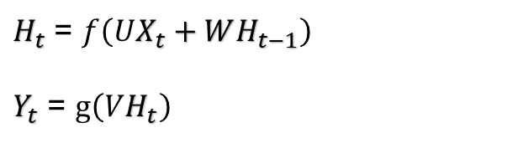

Output $Y_{t}$
V
$H_{t}$ = $f\left(UX_{t}+WH_{t−1}\right)$
$Y_{t}$ = $g\left(VH_{t}\right)$
Hidden state $H_{t}$
F
*$W_{hh}$
+
$$H_{t−1}$$
W
U
*$W_{xh}$
Input $X_{t}$

Slide 11
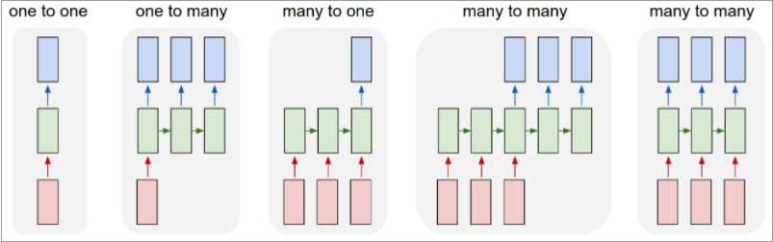

Slide 12
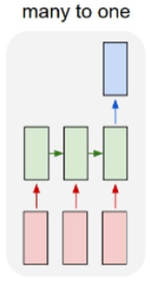

Output $Y_{t+1}$
Hidden state $H_{t}$
Hidden state $H_{t+1}$
Non-linear
Activation function ( tanh )
Non-linear
Activation function ( tanh )
*$W_{hh}$
*$W_{hh}$
+
+
$$H_{t−1}$$
Parameter matrix
$$H_{t}$$
Parameter matrix
*$W_{xh}$
*$W_{xh}$
Input $X_{t}$
Input $X_{t+1}$

Slide 13
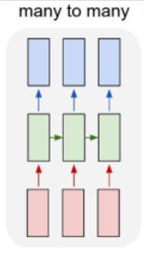
Output $Y_{t}$
Output $Y_{t+1}$
Hidden state $H_{t}$
Hidden state $H_{t+1}$
Non-linear
Activation function ( tanh )
Non-linear
Activation function ( tanh )
*$W_{hh}$
*$W_{hh}$
+
+
$$H_{t−1}$$
Parameter matrix
$$H_{t}$$
Parameter matrix
*$W_{xh}$
*$W_{xh}$
Input $X_{t}$
Input $X_{t+1}$

Slide 14
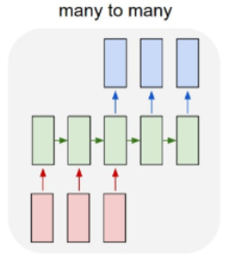
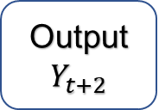

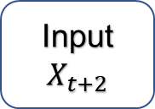
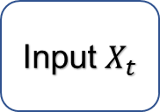
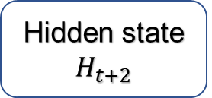
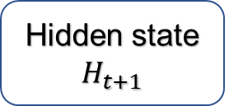

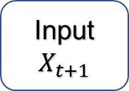
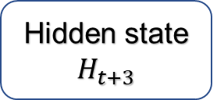
Output $Y_{t+2}$
Output $Y_{t+3}$
Hidden state $H_{t}$
Hidden state $H_{t+1}$
Hidden state $H_{t+2}$
Hidden state $H_{t+3}$
Input $X_{t}$
Input $X_{t+1}$
Input $X_{t+2}$

Slide 15
Decoding
Encoding
Output $Y_{t+2}$
Output $Y_{t+3}$
Hidden state $H_{t}$
Hidden state $H_{t+1}$
Hidden state $H_{t+2}$
Hidden state $H_{t+3}$
Input $X_{t}$
Input $X_{t+1}$
Input $X_{t+2}$

Slide 16
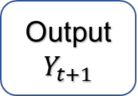
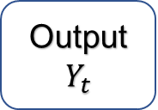
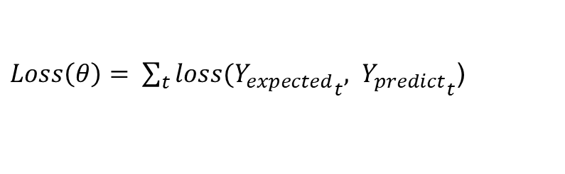
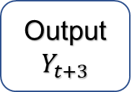

Expected
Data
Expected
Data
Expected
Data
Expected
Data
Calculate Loss
Output $Y_{t}$
Output $Y_{t+1}$
Output $Y_{t+2}$
Output $Y_{t+3}$
$Loss\left(θ\right)= \sum_{t}{loss({Y_{expected}}_{t}, }$ ${Y_{predict}}_{t}$)

Slide 17
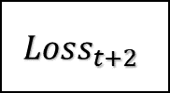

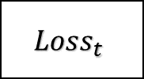
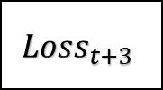
Expected
Data
Expected
Data
Expected
Data
Expected
Data
$${Loss}_{t}$$
$${Loss}_{t+1}$$
$${Loss}_{t+2}$$
$${Loss}_{t+3}$$
Loss
Output $Y_{t}$
Output $Y_{t+1}$
Output $Y_{t+2}$
Output $Y_{t+3}$

Slide 18
Expected
Data
Expected
Data
Expected
Data
Expected
Data
$${Loss}_{t}$$
$${Loss}_{t+1}$$
$${Loss}_{t+2}$$
$${Loss}_{t+3}$$
Loss
Output $Y_{t}$
Output $Y_{t+1}$
Output $Y_{t+2}$
Output $Y_{t+3}$
Back propagation

Slide 19

Output $Y_{t}$
Hidden state $H_{t}$
Loss
Back propagation
*$W_{hh}$
+
$$H_{t−1}$$
Parameter matrix
*$W_{xh}$
Input $X_{t}$

Slide 20




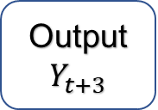

RNN, recurrent neural network
〮 Sequence 가 길어질 경우, Back propagation 을 할 때
Vanishing Gradient Problem 이 나타날 수 있다
Output $Y_{t+2}$
Output $Y_{t+3}$
V
Hidden state $H_{t}$
Hidden state $H_{t+2}$
Hidden state $H_{t+3}$
Hidden state $H_{t+1}$
W
Input $X_{t}$
Input $X_{t+1}$
Input $X_{t+2}$

Slide 21
LSTM, Long Short-Term Memory
〮 Introducing memory state in RNN
RNN에 메모리 셀을 추가하여 정보를 기억하는 용도로 사용한다

Slide 22
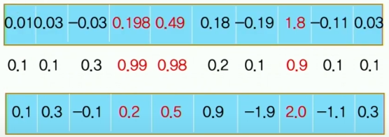
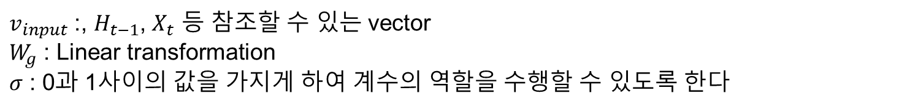

LSTM, Long Short-Term Memory
Gate : element wise 하게 계수를 곱해주는 역할
$σ(W_{g}∗$ $v_{input})$
$v_{input}$ :, $H_{t−1}$, $X_{t}$ 등 참조할 수 있는 vector
$W_{g}$ : Linear transformation
$σ$ : 0과 1사이의 값을 가지게 하여 계수의 역할을 수행할 수 있도록 한다
Gate

Slide 23






LSTM, Long Short-Term Memory
Output $Y_{t}$
LSTM cell
$$C_{t−1}$$
$$C_{t}$$
$$H_{t−1}$$
$$H_{t}$$
Input $X_{t}$

Slide 24




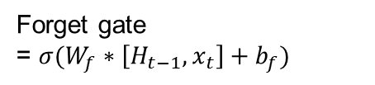
LSTM, Long Short-Term Memory
Output $Y_{t}$
Forget gate
= $σ(W_{f}∗\left[H_{t−1},x_{t}\right]+b_{f})$
LSTM cell
$$C_{t−1}$$
*
$$C_{t}$$
$$σ$$
$$H_{t−1}$$
$$W_{h}$$
+ $b_{f}$
$$H_{t}$$
$$W_{x}$$
Input $X_{t}$

Slide 25

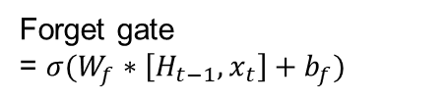


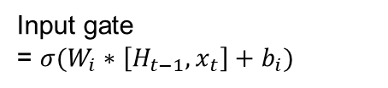

LSTM, Long Short-Term Memory
Forget gate
= $σ(W_{f}∗\left[H_{t−1},x_{t}\right]+b_{f})$
Output $Y_{t}$
Input gate
= $σ(W_{i}∗\left[H_{t−1},x_{t}\right]+b_{i})$
$$C_{t−1}$$
*
+
$$C_{t}= f_{t}∗C_{t−1}+i_{t}∗{C′}_{t}$$
w, b
*
$$σ$$
$$σ$$
$$tanh$$
$$H_{t−1}$$
w, b
w, b
$$H_{t}$$
${C′}_{t}$= $tanh(W_{c}∗\left[H_{t−1},x_{t}\right]+b_{c})$
Input $X_{t}$

Slide 26





LSTM, Long Short-Term Memory
Forget gate
= $σ(W_{f}∗\left[H_{t−1},x_{t}\right]+b_{f})$
Output $Y_{t}$
Input gate
= $σ(W_{i}∗\left[H_{t−1},x_{t}\right]+b_{i})$
$$C_{t−1}$$
*
+
$$C_{t}= f_{t}∗C_{t−1}+i_{t}∗{C′}_{t}$$
w, b
*
$$σ$$
$$tanh$$
$$σ$$
$$tanh$$
w, b
$$σ$$
$$H_{t−1}$$
w, b
*
$H_{t}=o_{t}∗tanh⁡(C_{t})$
${C′}_{t}$= $tanh(W_{c}∗\left[H_{t−1},x_{t}\right]+b_{c})$
$o_{t}$=$σ(W_{o}∗\left[H_{t−1},x_{t}\right]+b_{o})$
Input $X_{t}$

Slide 27
LSTM, Long Short-Term Memory
T 시점에서 Cell state 에 기록된 정보가 t+n에서 활용되었을 때
tanh 등의 non-linear activation function 을 통과하지 않기 때문에
Gradient Vanishing Problem 을 해결할 수 있다

